Slide 1


Capewell Solid-State Timer
Team 9:
ME: Patrick Dunham and Joshua Reinhart
EE: Patrick Meres, Robert Endrizzi, Nicole Hershman, and Jaileen Algarin
Faculty Advisors: Dr. Rajeev Bansal & Dr. Thanh Nguyen
Sponsor Representative: Andrew Smith

Slide 2
Presentation Outline
Project Requirements
Our Solution
Current Standing
Microcontroller (MCU)
Relays
Power Supply
User Interface (UI)
Enclosure
Schedule
Moving Forward

Slide 3
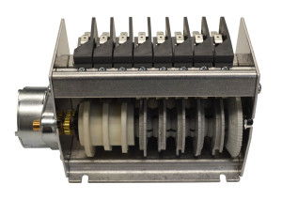
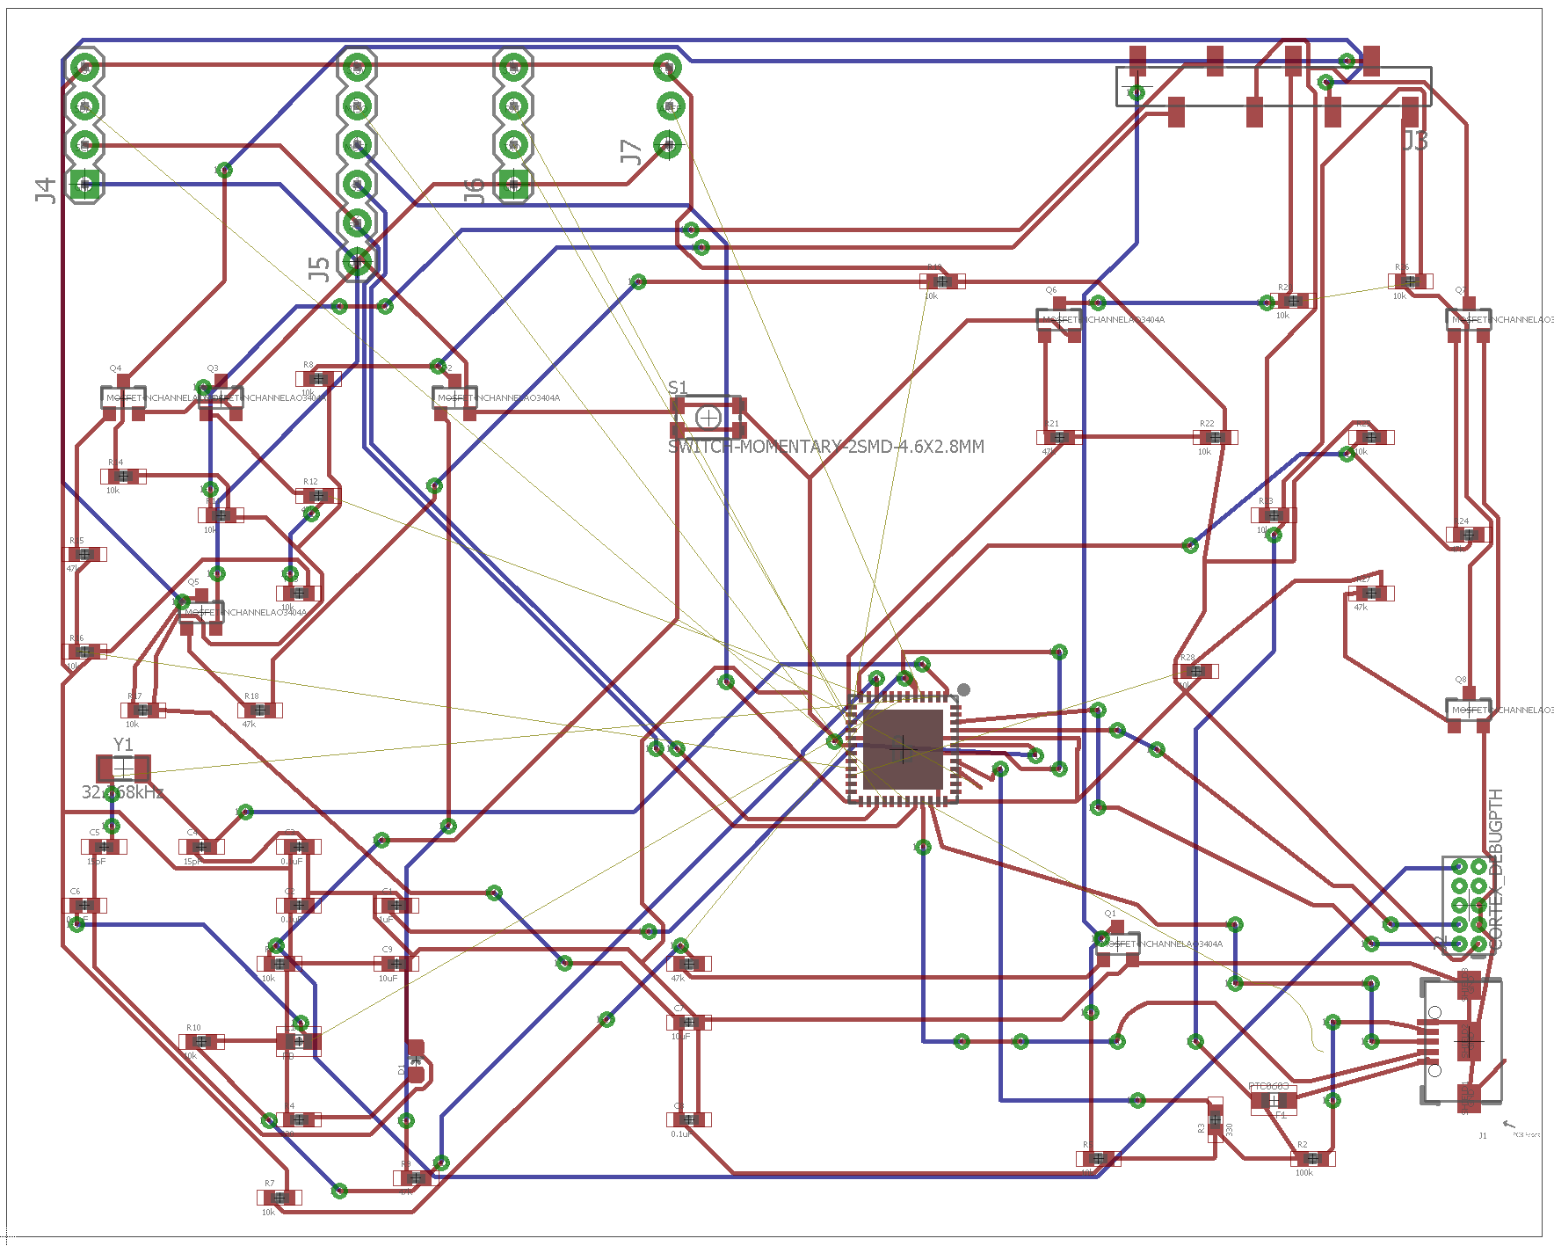
Project Statement
Goal: Redesign C10/C11 Electromechanical Cycle Timer
Design must meet or exceed all specifications of current timer
Design must be completely solid-state
Deliverables: Solid-State Timer Design & Source Code
PCB Design/Schematic
Enclosure CAD Files
Microcontroller Source Code
Working Prototype
Switches
Motor
Cams
Solid-State Timer PCB
8-Cam C10 Cycle Timer

Slide 4
Company Sponsor Requirements
Power:
Overall power usage below 3 Watts
Each relay can withstand a minimum load of 15 Amperes (Amps)
Timing:
Control between 4-8 individual timers
Each timer adjustable individually for a range of 60 - 120 seconds
Timers programmable in-house and by customer in the field
Timer accurate to within 0.25 seconds
Production:
Cost of $40 for parts
Enclosure
Enclosure footprint must match that of current cycle timer (5-1/2” long x 3-1/4” tall x 3” deep)
User Interface
Easily trainable/intuitive interface, Factory Interface must allow for individual relay lockout

Slide 5
What Is a Solid State Timer?
Solid - State: Circuits or Devices built entirely from solid materials, with electrons confined totally within the solid materials.
Design uses ARM Cortex M0+ Microcontroller (MCU) for control and Triodes for Alternating Current (TRIACs) in place of mechanical relays.
Both units contain no moving parts, satisfying requirements for a solid-state device.

Slide 6
Our Solution: Solid-State Timer
Work Breakdown

Slide 7
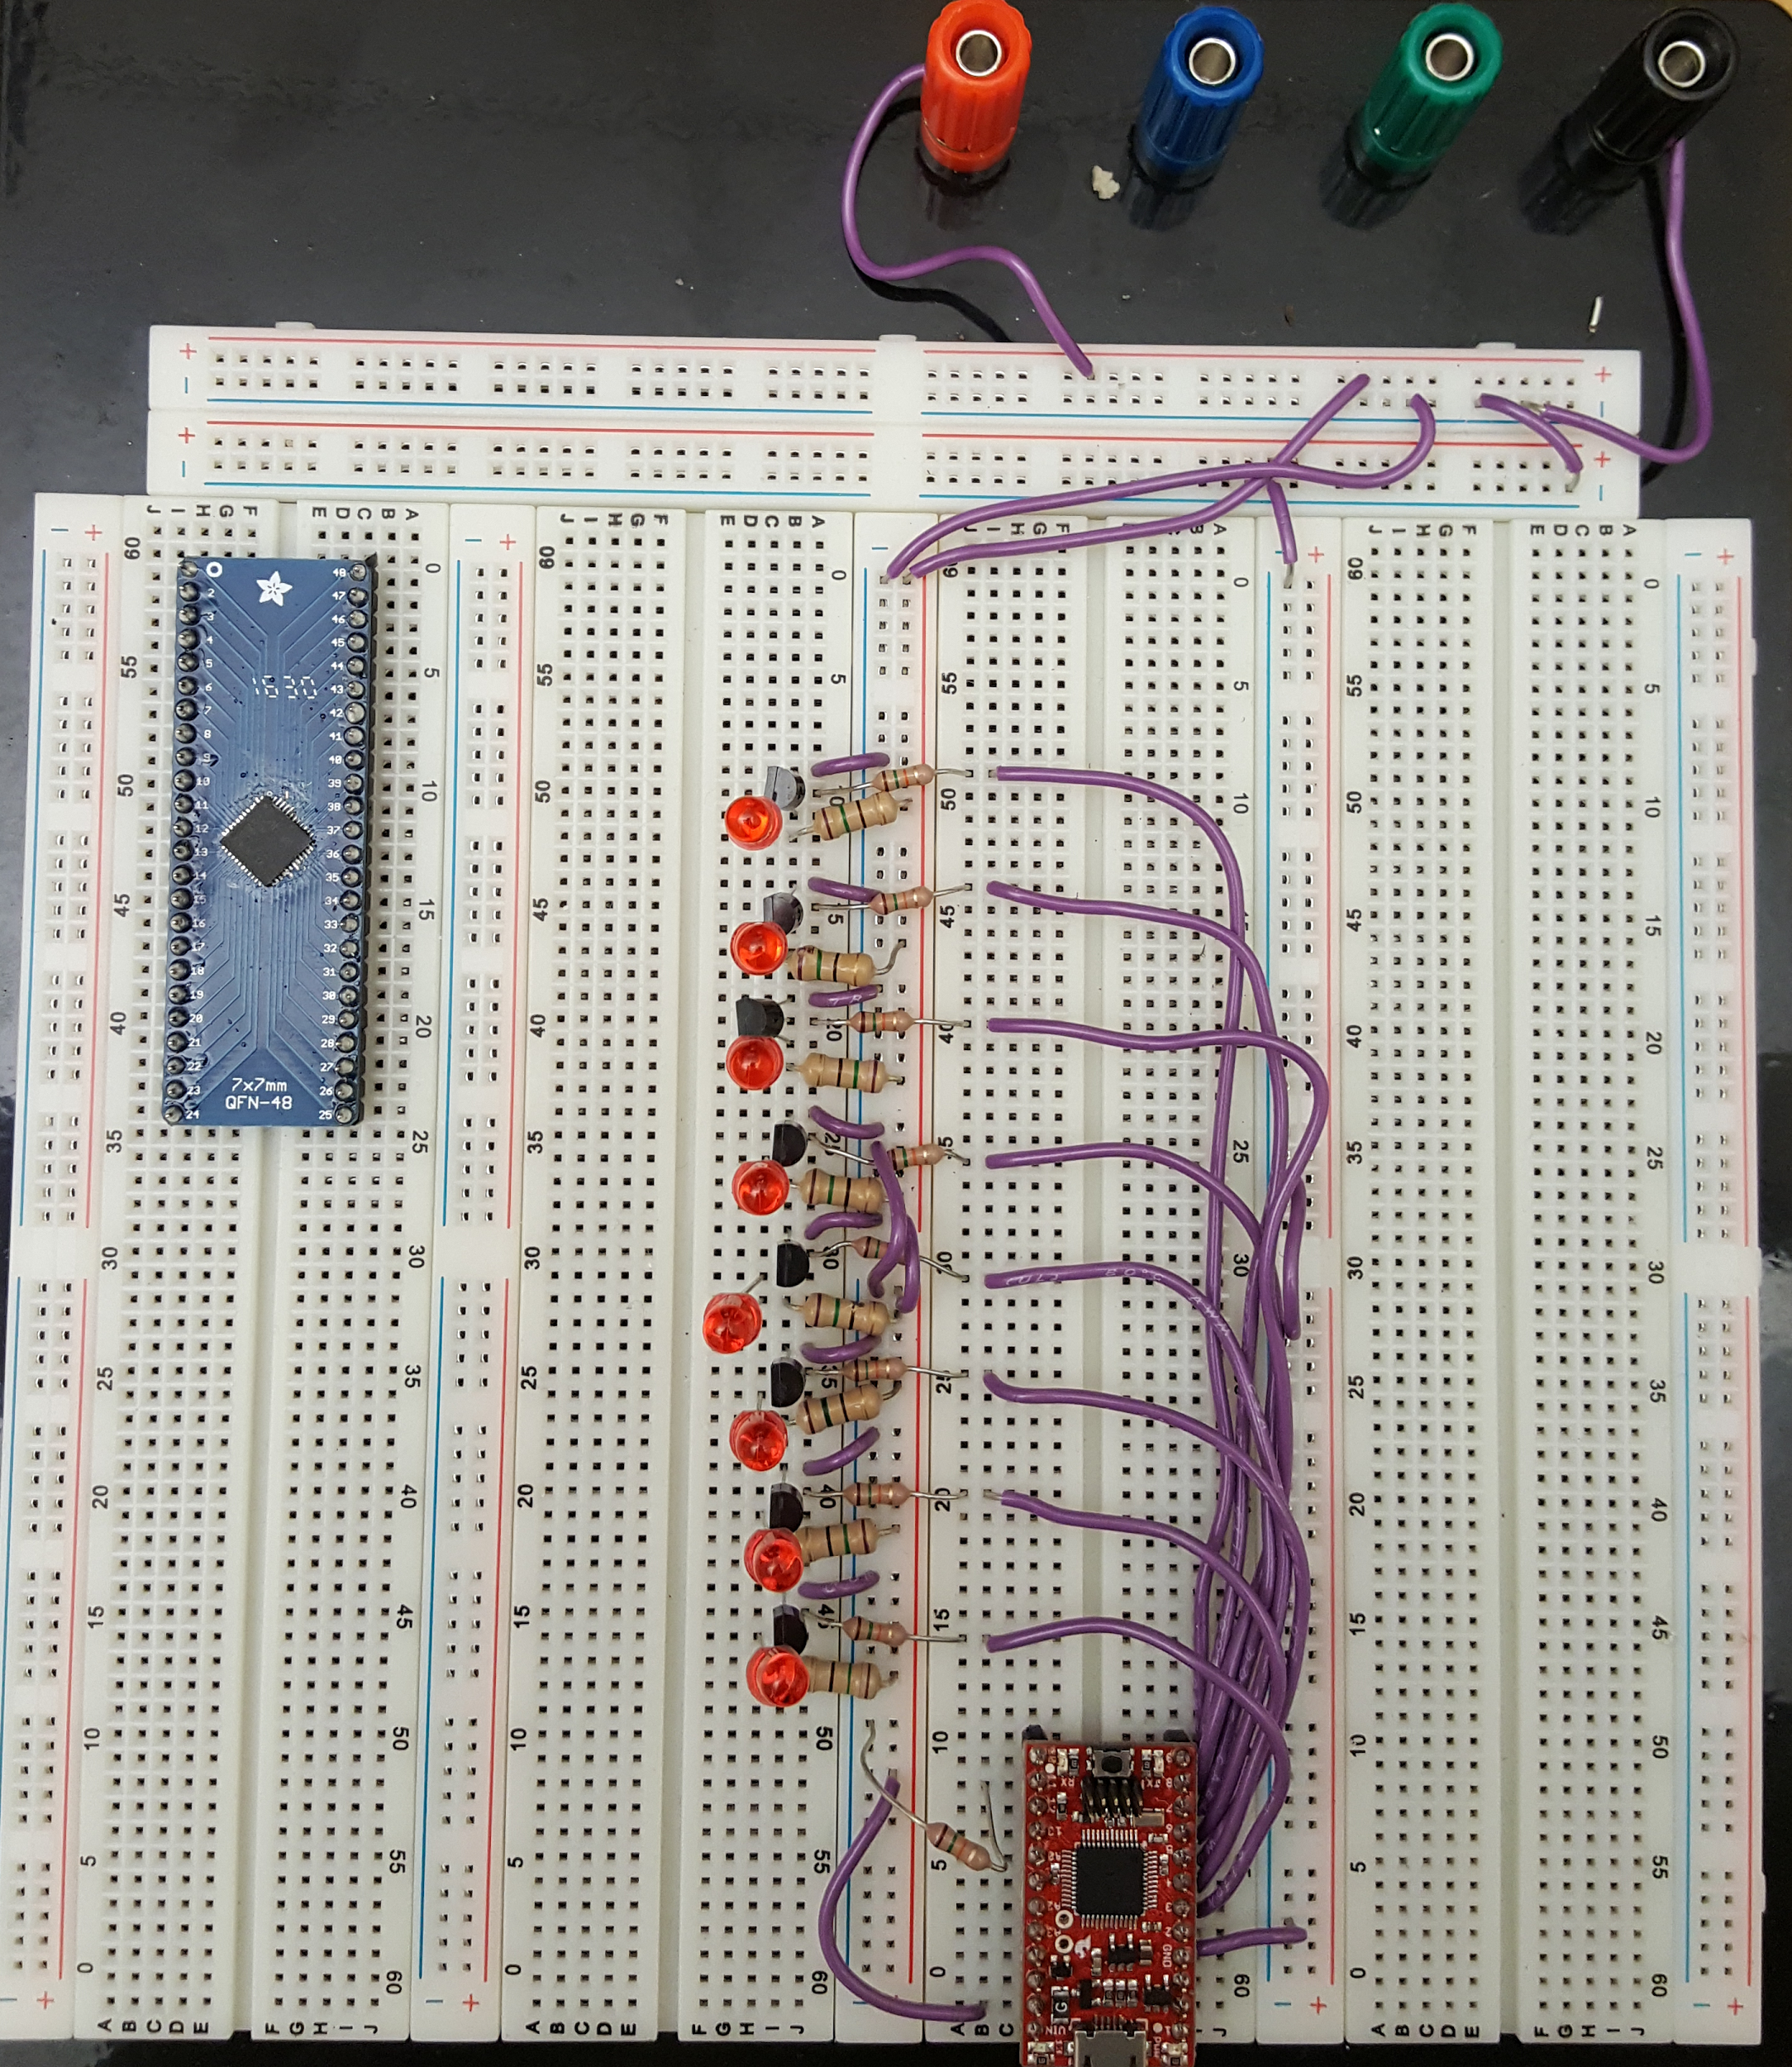
Microcontroller: Operation
Firmware constructed from 3-state State Machine
Idle State: “Pauses” the cycle
Cycle State: Runs the cycle, turns on/off relays
Reset State: Resets cycle, prepares for new run
Current Prototype
State Machine Diagram

Slide 8
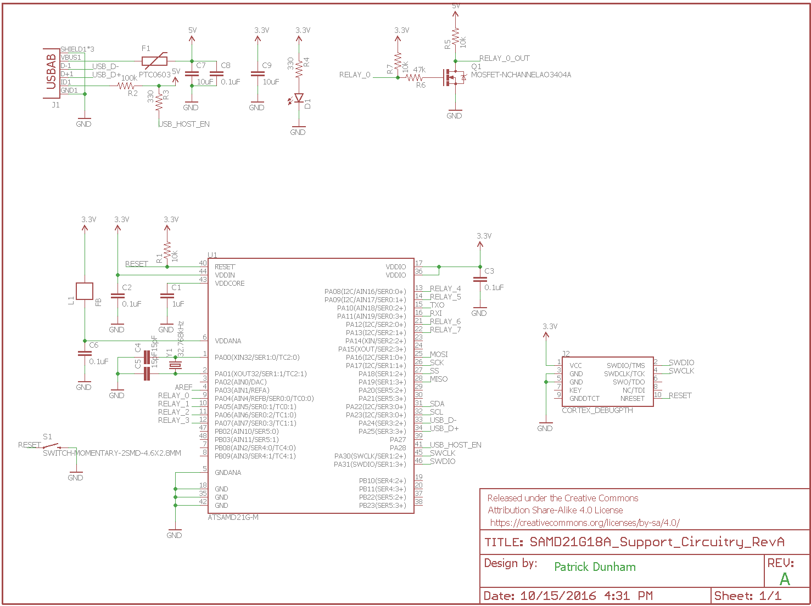
Microcontroller: Schematic
USB Connector
Relay Controller (x8)
Microcontroller

Slide 9
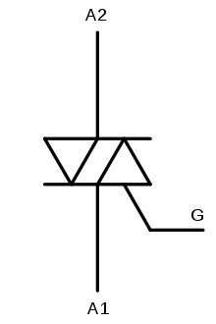
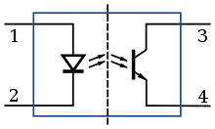
Solid-State Relays: TRIACs
TRIACs: Semiconductor devices that can conduct current in both the positive and negative direction.
Optoisolators: Components that isolate electrical circuits by transferring logical signals using light.
TRIAC
Optoisolator

Slide 10
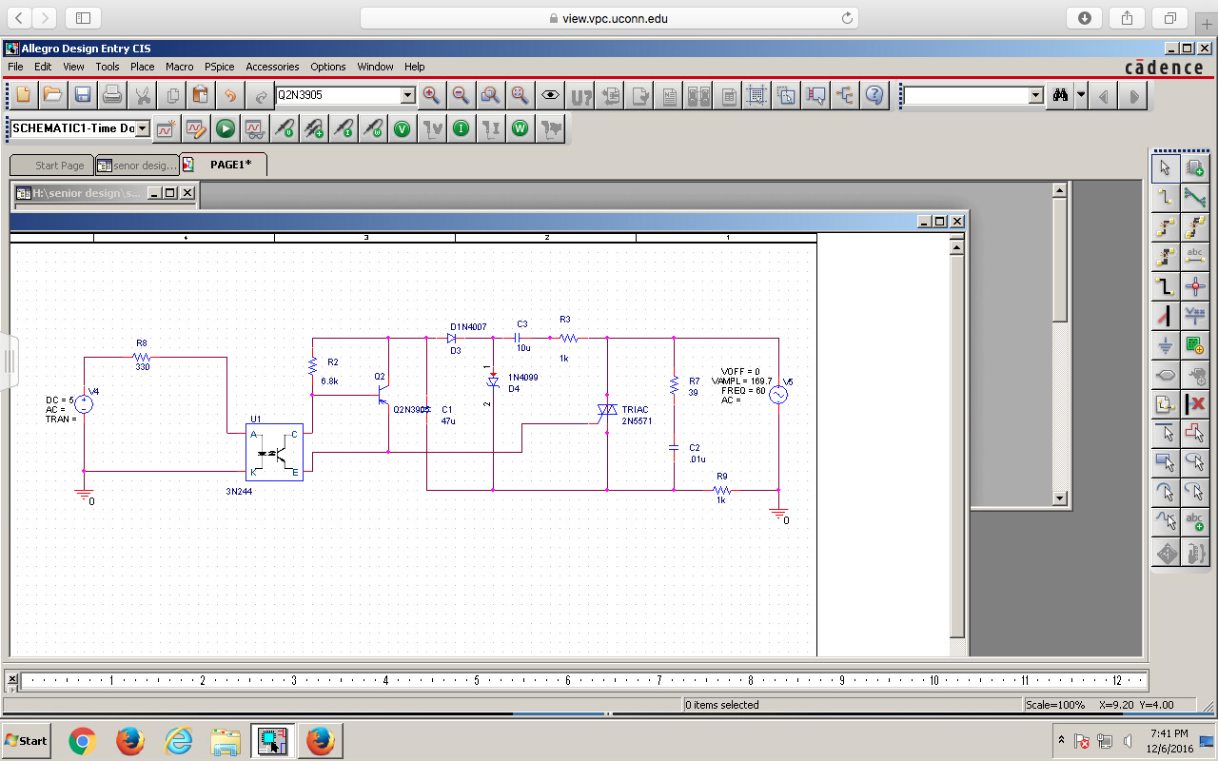
Solid-State Relays: Schematic
Optoisolator
TRIAC
Load

Slide 11
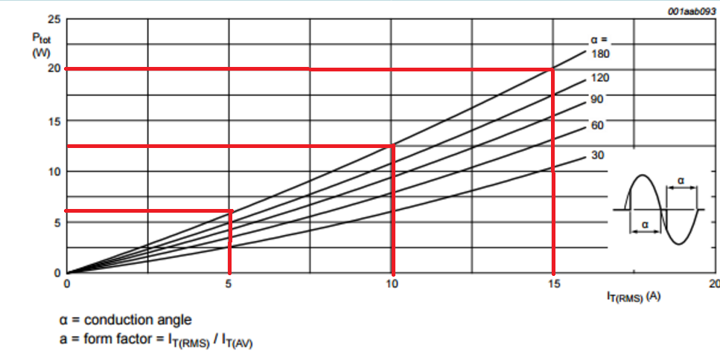
Preliminary Concerns
Heat output: ~1 Watt / Amp
R_{TH}(w/o heatsink) : 60 K/W
At 15 A, 15 W of heat is produced (∆T > 900 K!)
Ambient Temp = 60 C
Max Device Temp = 125 C
Need heatsink w/ R_{TH}< 3.13 K/W
Power Dissipation vs. RMS Current (From BT139-800E Documentation)
Notes:
Figure taken from BT139-800E data sheet

Slide 12
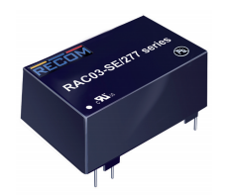
Power Stage: Board Mount Solution
AC/DC Converter
Cost: ~$15
Output Voltage: 5 V
Output Current: .6 A
Power: 3 W
Input Voltage: 85-264 VAC
Power Converter Chip

Slide 13
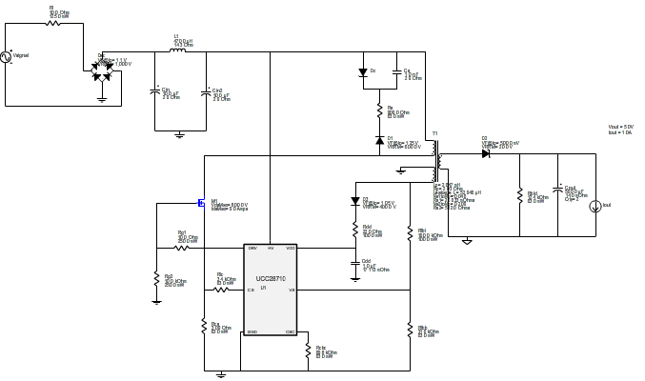
Power Stage: Custom Solution
Multistage Switching Converter: Primary Flyback Converter Schematic
Rectifier
Controller
Flyback Converter

Slide 14
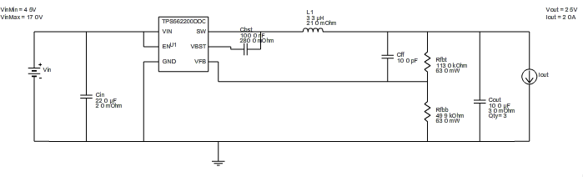
Buck Converter Schematic
Multistage Switching Converter: Secondary Buck Converter Schematic
Controller/Converter

Slide 15
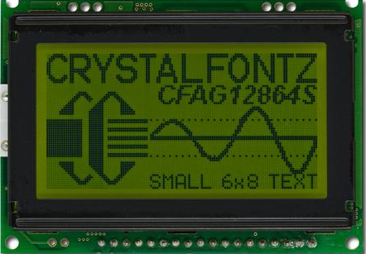
User Interface (UI)
Graphics LCD Screen
Specs
128x64 Display
Size: 2.953 in x 2.075 in x 0.35 in
8-bit Parallel Communication Interface
method of conveying multiple binary digits (bits) simultaneously.
It contrasts with serial communication, which conveys only a single bit at a time
-20 to +70 degrees C
Programmed in C language
User control:
Capacitive Buttons
Durability, cost, easy, smaller chance of false readings
Graphic Display

Slide 16
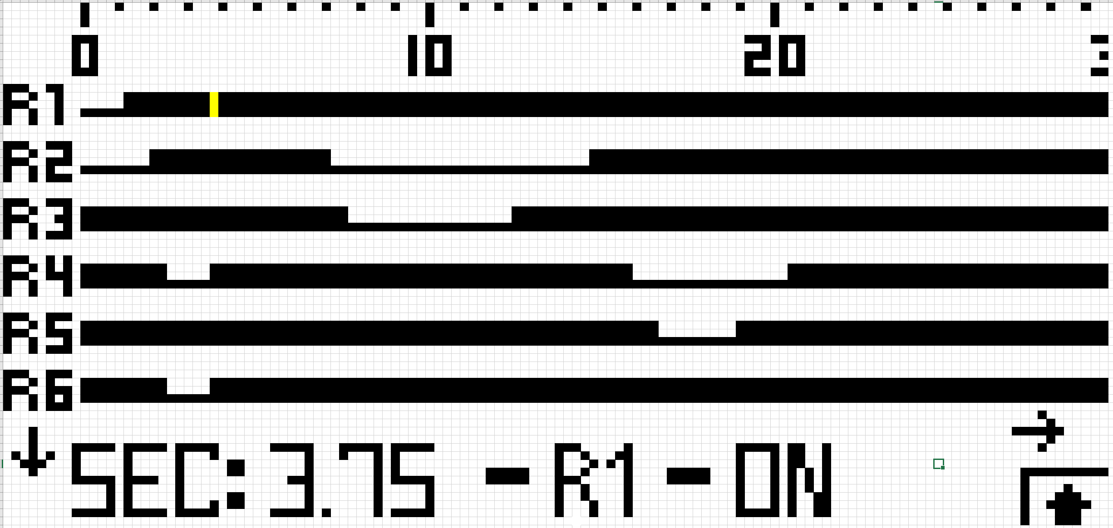
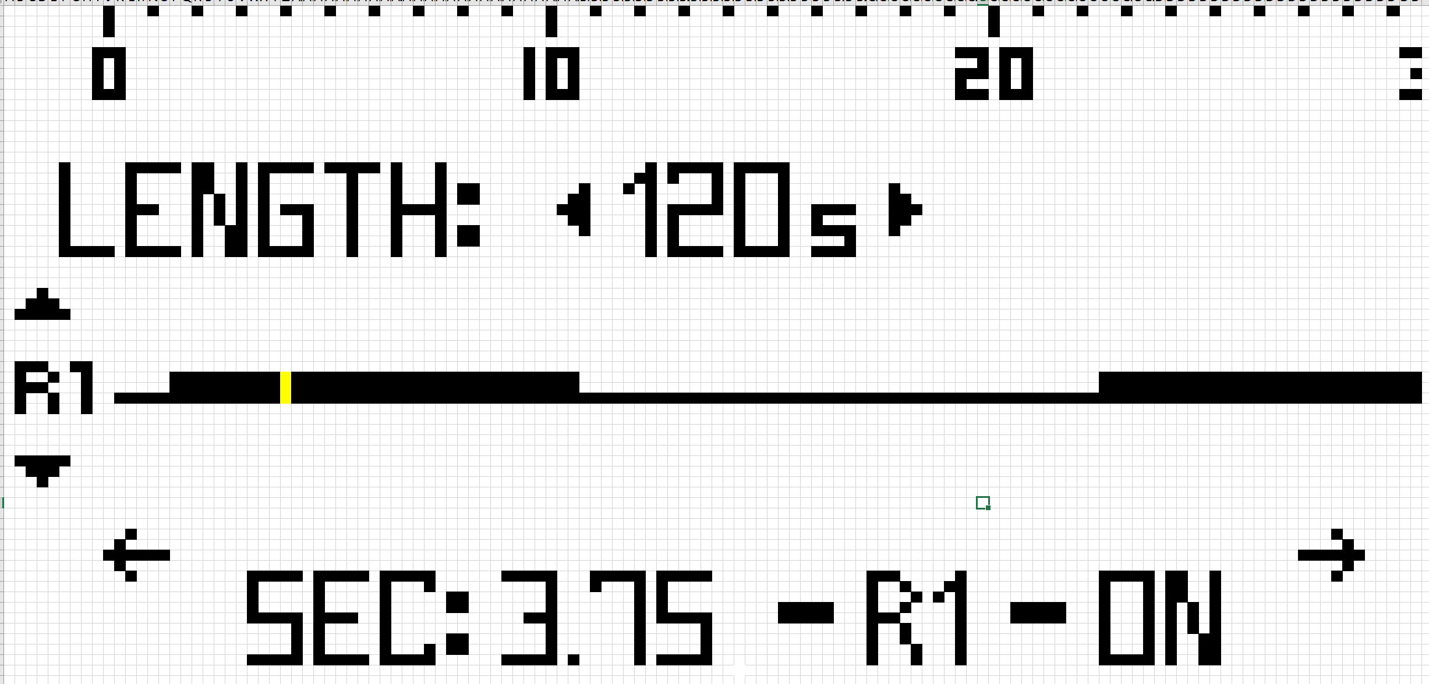
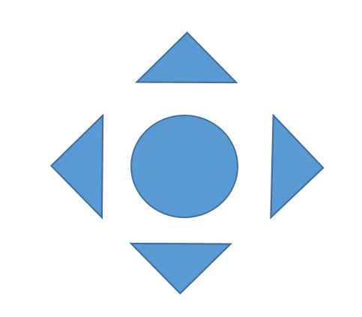
Implemented UI Design
Display for LCD Screen
Timing Diagram
Each Pixel Represents .25 seconds
Button Layout

Slide 17
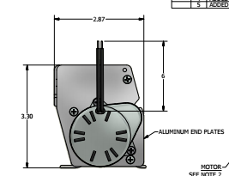
Enclosure: Operation
Must match original enclosure footprint
Construct from injection-molded plastic or sheet aluminum
Does not need to be dustproof/waterproof
Concerns are responsibility of customer

Slide 18
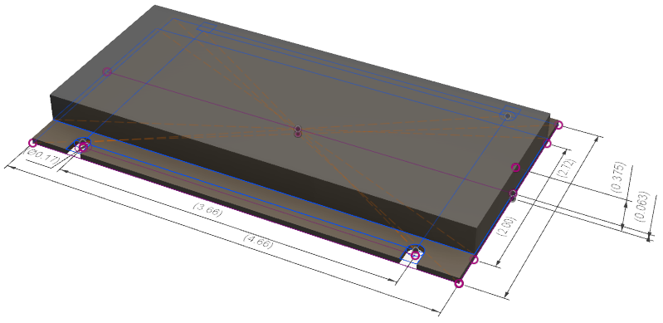
Enclosure: Design
Dimensions in inches

Slide 19
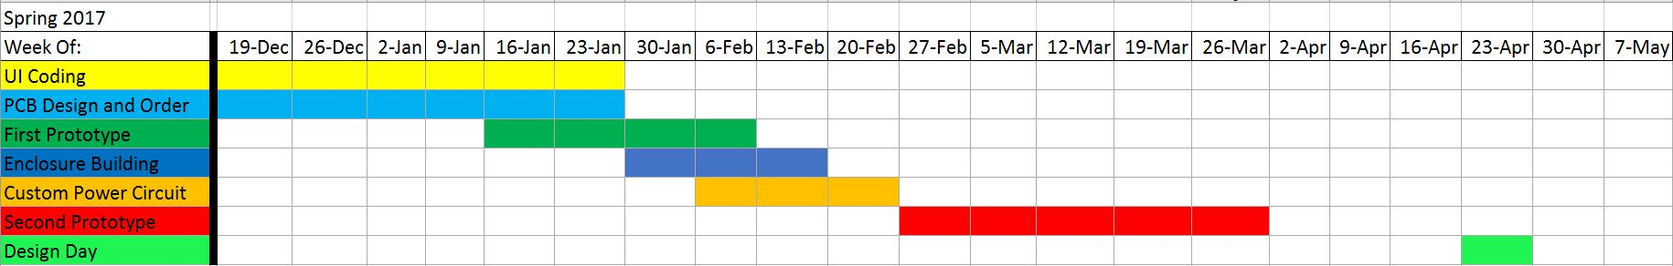
Schedule
Dec. 19 - Order 1st PCB, Begin UI Coding
Jan. 30 - Test 1st PCB in Enclosure, Finish 1st Prototype on PCB
Feb. 27 - Order 2nd PCB, Finish Custom Power Supply Design
Apr. 2 - Finish 2nd Prototype

Slide 20
Moving Forward
Finish & Test Coding
User Interface
Breadboard Prototype
Have PCB printed out
3D print out our Enclosure
Assemble overall prototype using PCB and Enclosure
Test and modify from there

Slide 21
Team Assessment
Presentation Style
Readability of Slides
Clarity of Project Objectives and Deliverables
Clicker Scoring
A - “I get it” - Clear, Nice Job!
B - “I kind of get it” - Needs More Work
C - “I’m confused” - Needs Lots of Work

Slide 22
Who Is Capewell?
“Capewell Aerial Systems is a global leader in aerospace and life support. We are a respected provider of engineered products for aerial delivery, life support and tactical gear for military, law enforcement and humanitarian agencies worldwide. Founded in 1881, Capewell has thrived by helping customers conceive, engineer, prototype, manufacture and field test products that must perform flawlessly in critical situations.”

Slide 23
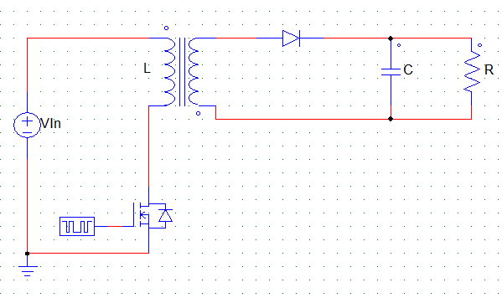
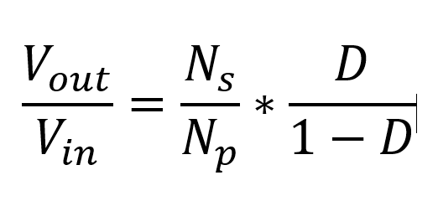
Flyback Converter: Basics
Uses inductor, capacitor, and switching device (transistor) to change DC voltage levels. Transformer provides electrical isolation.

Slide 24
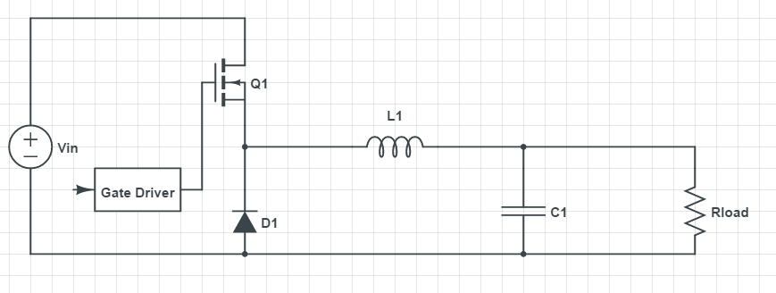
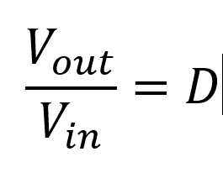
Buck Converter: Basics
Uses inductor, capacitor, and switching device (transistor) to change DC voltage levels. Output voltage must be lower than input.

Slide 25
Prototype Budget
This is a list of the components we have ordered for our prototype. This is all taken out of our total budget of $1000.
Quantity | Item | Model Specifics | Cost
2 | Development Boards | ATSAMD21G18A | $19.95 each
1 | ATMEL Programmer | ATMEL-ICE | $94.67
1 | Graphic LCD Display | CFAG12864S-YYH-VT | $17.00
3 | Microcontroller Unit | ATSAMD21G18A | $5.28 each
2 | Breadboards | PRT-12614 | $19.95
10 | Optocouplers | VOM617A-4T | $0.39 each
10 | TRIACs | BT139-800E,127 | $0.78 each
10 | MOSFETS | 2N7000 | $0.24 each
1 | AC/DC Converter | 945-2246-ND | $15.45
 |  |  | Total: $216.91

